Slide 1

AI IN AUTOMOBILE
A CASE STUDY

Slide 2
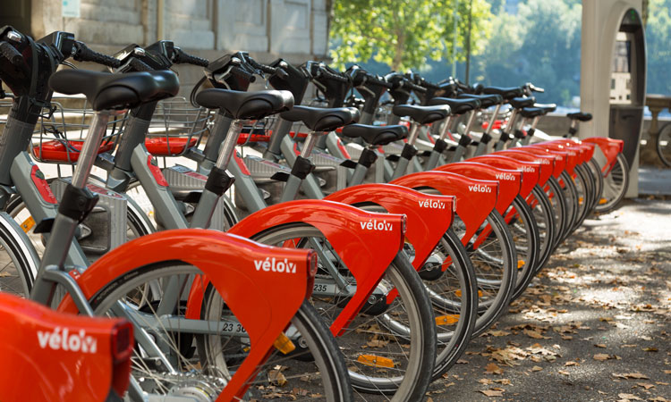
BIKE RENT SHOP
A BIKE RENT SHOP to predict the demand of bikes at any given hour of the day, so that, they can arrange for sufficient number of bike for the customers.
DATA GIVEN : They have shared the hourly rental data for last two years.

Slide 3
OBJECTIVE
To create a machine learning model which can predict the count of bikes rented at a given hour of the day.

Slide 4
Model building layout.
1*
Data exploration
2*
Data cleaning, manipulations and analysis
3*
Building various ML models
4*
Selecting the best model for prediction.

Slide 5
About the Algorithm selected.
RANDOM FOREST REGRESSOR
Random Forest is a popular machine learning algorithm that belongs to the supervised learning technique. It can be used for both Classification and Regression problems in ML. It is based on the concept of ensemble learning, which is a process of combining multiple classifiers to solve a complex problem and to improve the performance of the model.

Slide 6
THANK YOU!

